Slide 1
Strategic Objectives Planning Session

Slide 2
Agenda
Introduction
Competitive Intelligence
Aspirations
SWOT Analysis
Roadmap – Action Plan
Future – 3.0
Define Organizational Long Term Impact
Understand the Competitive Landscape
Develop a Strategy for Taking McBee to the Next Level
Develop a Strategic Plan to Maximize Likelihood of Success

Slide 3
Maximizing Value Creation
Start Up
Growth
Maturity
Transformation
Value Creation
Gap
Meeting Need
Success
Unlocking New Value

Slide 4
Pyramid of Success
Define Organizational Structure, Including EC and Staff Roles and Functions
Business Plan Actions, Leadership Commitments, Resources
Aspirations
Vision, Mission, Goals, Objectives
Positioning/Branding
Value Proposition - Reasons for Companies to Retain McBee – Differentiation Matrix
Core Competencies – Elevator Speech
Notes:
It is important to have a strategy that articulates a shared vision

Slide 5
Trends in Your Practice Areas

Slide 6
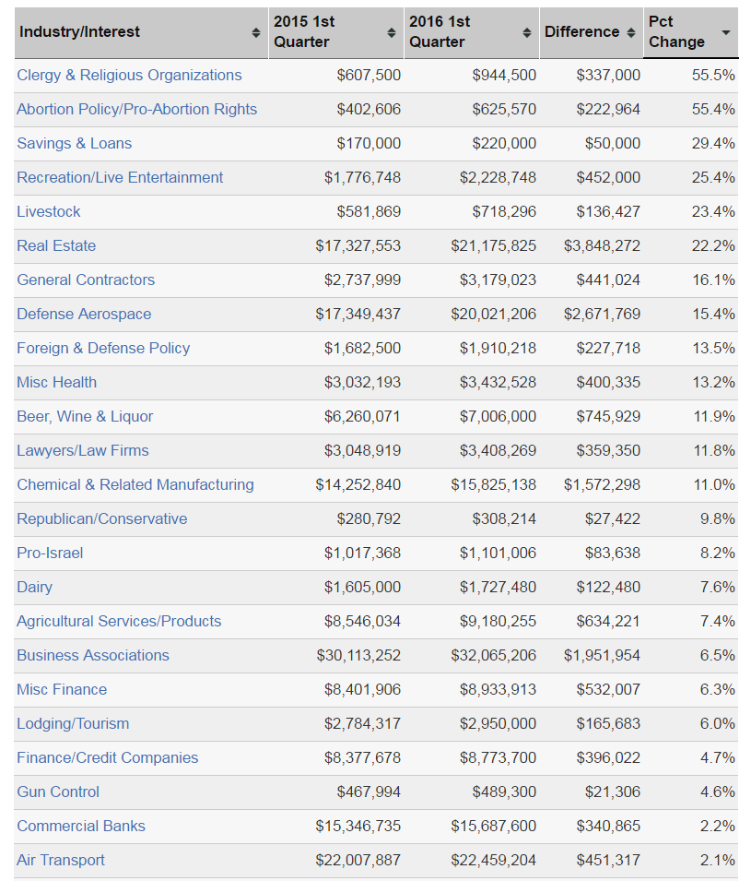
What Industries Are Up and What Industries are Down
Growth Areas
Government Contracts
Foreign Policy
Down
Environment
Waste Management
Mining

Slide 7
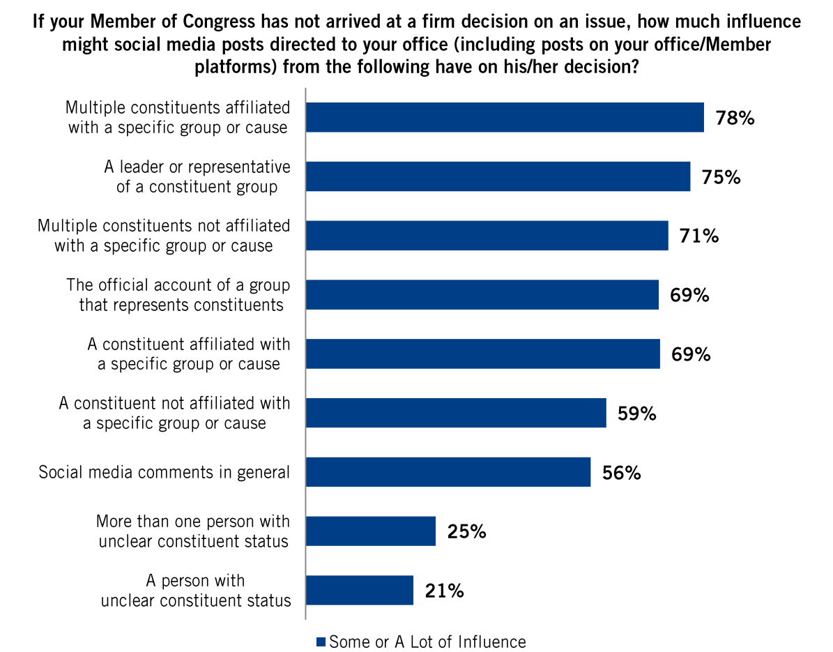

Slide 8
Bigger Firms Aren’t Better: Many of the biggest firms have posted declining revenues and shrinking client lists. Meanwhile, smaller lobbying shops are on the rise. Each week brings new Politico Influence reports of lawyers and lobbyists breaking off of their larger firms to “hang a shingle” at their own, new firms.
Specialized beats general and access
Political intelligence and research is now playing a bigger role
Coalitions are on a rise to advocate for niche issues

Slide 9
Competitive Intelligence

Slide 10
Competition
Communications
Podesta Group (PG)
Qorvis
Glover Park Associates (GPA)
Levick
Mercury Public Affairs
Lobbying
Alpine Group
Cornerstone Government Affairs
Forbes Tate
Mehlman Castagnetti
Peck Madigan
Notes:
Podesta is moving towards PG – to disassociate from name, Glover Park is moving towards GPA

Slide 12
Team Structure - TOTAL est. 75
2 Chairman/CEO
33 Principals (incl. 2 Managing Principals)
12 - Vice Presidents (incl. 4 with additional Director titles - Digital; Marketing and Corporate Brand; Creative; Regulatory)
5 Director w/o Vice President Title
5 Managers
5 – Associates (Jr. Staff – incl. Graphic Designer; Writing)
5 Admin
Notes:
Clinton connections

Slide 13
Team Structure By Practice
Government Affairs: 41
Public Relations: 17
Digital: 8 (several cross with PR)
Global: 18 (cross with other practices)

Slide 14
Financials - LDAs
YTD 2016 - $5,940,000
2015 – $23,180,000
2014 - $25,100,000
Podesta went from earning earned $3.2 million in public relations revenues in 2010 to $9 million in 2015, according to firm-provided figures. Hill article 2/9/16

Slide 15
Established in 1987
Always original, never ordinary, we imagine and execute inventive, integrated, data-based campaigns that don’t just ignite conversations, but inspire action and change outcomes

Slide 16
Promote the “top-ranked” bipartisan team of tested global advocacy and strategic communications specialists.
Bloomberg Businessweek calls us a “Beltway blackbelt”

Slide 17
What They Do – PG PR
We believe in the power of integration.
Whether seeking increased market share or policy changes, our professionals understand how persuasive messages informed by data, and propelled by smart media placements, a high-profile speech, targeted digital outreach, dynamic content, effective advertising, or a strategic event can advance a communications agenda.
We are storytellers.

Slide 18
39 “Wins” – Client Case Studies

Slide 20
Clients
Aca International
AECOM Global
AECOM Technology Corp
Air Line Pilots Assn
Alphabet Inc
Altegrity Inc
American Health Care Assn
American Museum of Natural History
Amgen Inc
Assn Public & Land-Grant Universities
BAE Systems
Bank of Montreal
Baylor College of Medicine
Bechtel Group
Blue Cross/Blue Shield
BP
Brooks Development Authority
Business Roundtable
Canada Pension Plan Investment Board
Ceannate Corp
Children's National Health System
Children's National Medical Center
China-US Exchange Foundation
Christian Science Cmte on Publication
Civitas Capital Group
Commonwealth of Puerto Rico
Crawford Group
Creative Assoc International
Credit Suisse Group
DaVita Healthcare Partners
Debevoise & Plimpton
Deloitte LLP
Deutsche Telekom
Diageo PLC
DICE International Security Services
Dorchester Group
ECMC Group
Expansion Funding Partners LLC
Financial Industry Regulatory Authority
FlexTech Alliance
Fulcrum BioEnergy
General Dynamics
General Electric
Gerchen Keller Capital
Gilead Sciences
Global Strategies Group
Golden Pass Products
Herbalife International
Himbara, David
Hitomi Financial
Human Longevity Inc
Independent Film & Television Alliance
Infilaw Corp
Institute of Scrap Recycling Industries
International Soc for Photo Optical Instrument
Investment Co Institute
Ion Media Networks
Islami Bank Bangladesh

Slide 21
Nuclear Energy Institute
Ofori & Assoc
Ontario Teachers' Pension Plan Board
Optical Society of America
Oracle Corp
Orange County, FL
Organic Trade Assn
PAE
Pearl TV
Perceptics LLC
Popular Inc
Professional Services Council
PTC Inc
Pullman Road Wind Power
Radiation Therapy Alliance
RELX Group
Ripple Labs
Scotts Miracle-Gro
SeaWorld Parks & Entertainment
SecondMarket Holdings
Security Land & Development Co
Securitypoint Media
Shaw Industries Group Inc
Shorts International
SolarCity Inc
SolarReserve
Sotheby's Holdings
South Carolina Ports Authority
Stonegate Mortgage
SunEdison Inc
Syngenta AG
Synthetic Genomics
Tamil American Peace Initiative
TE Connectivity
Textron Inc
TV One LLC
University of Miami
Uranium One
US Foods
Voya Financial
Wachtel, William
Wal-Mart Stores
Wells Fargo
West African Land Holdings
West African Real Estate Holdings
Yiwen USA
Zenefits
ZTE USA
Kindred Healthcare
KKR & Co
L'arche Green NV
Lockheed Martin
Lyft Inc
MBDA Inc
Merck KGaA
Michelin North America
Microstrategy Inc
Minority Cellular Partners Coalition
Monsanto Co
Monster Energy Co
National Assn of Broadcasters
National Confectioners Assn
National Hispanic Council on Aging
Nationstar Mortgage
NAVIGATE
Nestle SA
Nestle SA
New York State Broadcasters Assn
Novartis AG

Slide 22
Strategic Plan

Slide 23
Six Strategies to Instill Ownership
Organization
Leadership
1. Planning to allocate ownership
1. Creating shared sense of responsibility
2. Ensuring clarity of expectations
2. Showing respect and appreciation
3. Facilitating open communication
3. Training team members

Slide 24
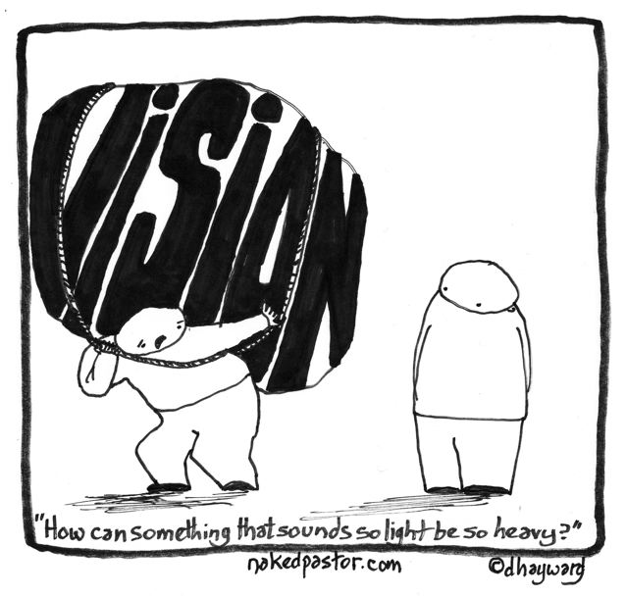

Slide 26
Our Highest Aspirations
Where Are We Heading?

Slide 27
Visuals for a Best of the Best “Influence”
Blog Posts
4 Years from Now
Aspirational Best Possible Stories to Tell

Slide 28
HELPFUL
to Achieving the Objective
HARMFUL
to Achieving the Objective
SWOT Analysis
STRENGTHS
WEAKNESS
OPPORTUNITIES
THREATS
Internal Origin
(current attributes of organization)
External Origin
(current attributes of community/industry)
Break Into Groups

Slide 29
Assessing Your Competitive Position Strengths & Weaknesses
Strengths – internal to McBee competencies in your practice; characteristics or qualities that make us better than our competitors. Add any additional strengths that are unique to McBee.
Weaknesses – internal to McBee’s competencies; characteristics or qualities that make us look weaker than our competitors. Add any additional gaps that are unique to McBee.

Slide 30
Assessing Our Strengths
What is our reputation in the marketplace?
What do we offer that is valuable and unique to clients that our competitors don’t?
If you were a client, why would you retain us?
Why would you join McBee?
Are we actively growing clients? If so, what has worked in the last 12 months that we should repeat?
Are our business approach and business development efforts effective?
What currently makes us a success?
How do we capture new business, and why do clients stay with us?
What are clearly defined benefits/key selling points of being associated with McBee?

Slide 31
Assessing Our Weaknesses
What is our reputation in the marketplace?
If you were a client, why wouldn’t you retain us?
What didn’t we do well this year? What do we need to improve upon next year?
What have you seen other organizations (i.e. “competitors”) do that you envy?
Why do we lose business to our competitors?
What are the weakness of our business development approach?
What things do we need to do better in order to compete for new business versus our competitors?
What have our competitors done better than us over the last two years?

Slide 32
Assessing Our Competitive Position
Opportunities for Firm within the industry sector. What are the service areas we can develop in this space?
Threats to Firm within the industry sector. Can we realistically continue to compete in this space?

Slide 33
Assessing Opportunities
What will be our firm’s greatest opportunities in the next 24 months?
What are some major trends in strategic communications that could create new opportunities for us?
What are some major trends in government affairs that could create new opportunities for us?
What firmwide areas should we focus on for cross-selling and driving new business?
Where can we find, or create, a competitive advantage?
Are there changes in the demand for certain types of services we offer? If so, what are they?
What legislative, regulatory, or business activities could create new opportunities for us?

Slide 34
Assessing Industry Threats
What will be our firm’s greatest challenges in the next 24 months?
Are there other firms that are actively pursuing our clients? What are they offering or doing that we are not?
What external obstacles do you face when pursuing new business?
What are our competitors doing that you think may result in a loss of clients or market share?
What are some major trends in strategic communications that could negatively impact our business?
What are some major trends in government affairs that could negatively impact our business?

Slide 35
HELPFUL
to Achieving the Objective
HARMFUL
to Achieving the Objective
SWOT Analysis
STRENGTHS
WEAKNESS
OPPORTUNITIES
THREATS
Internal Origin
(current attributes of organization)
External Origin
(current attributes of community/industry)

Slide 36
Reality Check - Growth Areas
Strengths | Challenges | Opportunities | Weaknesses

Slide 37
Reality Check - Client Value and Loyalty
Strengths | Challenges | Opportunities | Weaknesses

Slide 38
Reality Check - Attract Talent
Strengths | Challenges | Opportunities | Weaknesses

Slide 39
Reality Check - For Retain Talent
Strengths | Challenges | Opportunities | Weaknesses

Slide 40
Reality Check - Develop Talent
Strengths | Challenges | Opportunities | Weaknesses

Slide 41
Reality Check - Community
Strengths | Challenges | Opportunities | Weaknesses

Slide 42
Reality Check - Business Development
Strengths | Challenges | Opportunities | Weaknesses

Slide 43
Who Does it (possibly) Better and why? Our Top 3 Competitors in This Space
Firm Name | Their Strengths | Their Weaknesses

Slide 44
Activity
and
Actions!

Slide 45
Activity
What will we need to do different in the next two years?
What Should Our Service Delivery Model Be in five years?
What Type of People Should We Hire – Our Set of Capabilities?
Who Do We Need to Promote and Invest In?
How will we structure our client relationships?

Slide 46
What Are Our Next - Steps and Actions
Activity | Deadline | Resources Needed (Human Capital and $)

Slide 47
Three Actions You Commit to Doing in the Next 12 Months?

